Slide 1
Advance Statistics

Slide 2
Machine learning
ML Types
Supervised : with Labels, training
Unsupervised: Without any labels, Only Computer finds patterns, learn by self !!

Slide 3
Supervised
Classification
Regression

Slide 4
unsupervised
Clustering
Associations - Rules

Slide 5
Plotly
Seaborn
Scikit
Karas
Tensorflow

Slide 6
classification
Decision Tree
Gaussian Distribution – normal
Stochastik Gradient descent SGD
Nearest Neighbour
Bayesian Regression

Slide 7
Neural Network
Biological
Artificial NN

Slide 8
Neurons
Connections
Propagation
Learning Rule
LSTM: Long short term memory

Slide 9
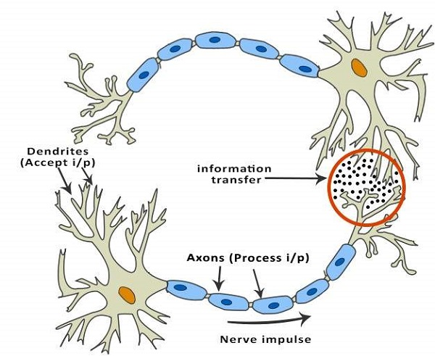
Neurons

Slide 10
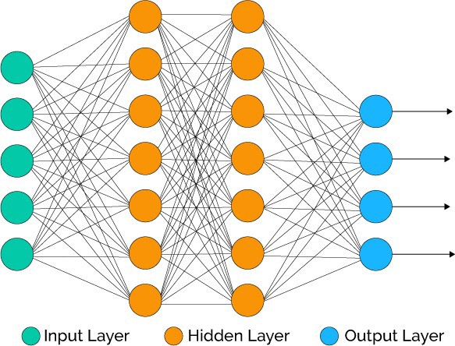
NN

Slide 11
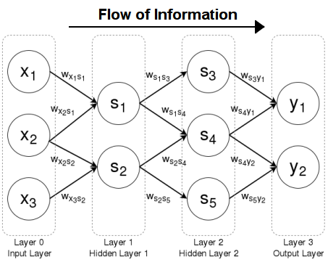
Feed Forward

Slide 12
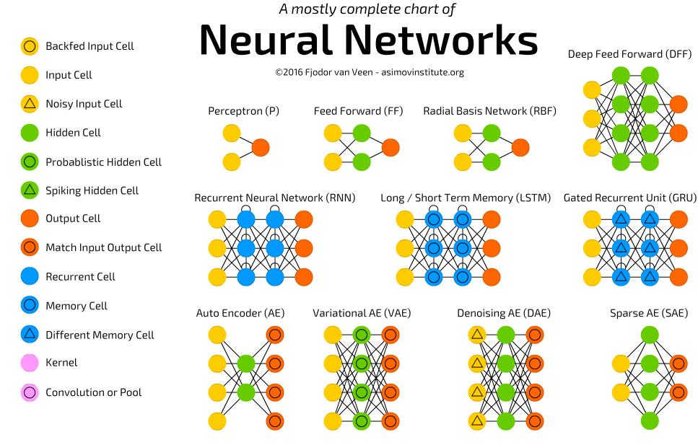

Slide 13
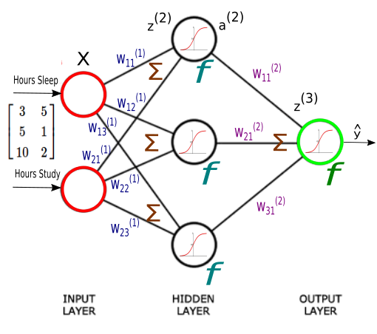

Slide 14
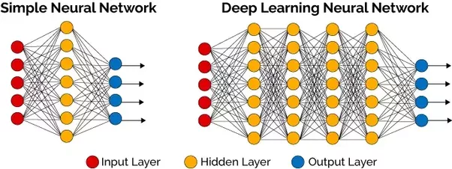
NN – Deep NN

Slide 15
Types of ANN
Single Layer
Multiple Layer

Slide 16
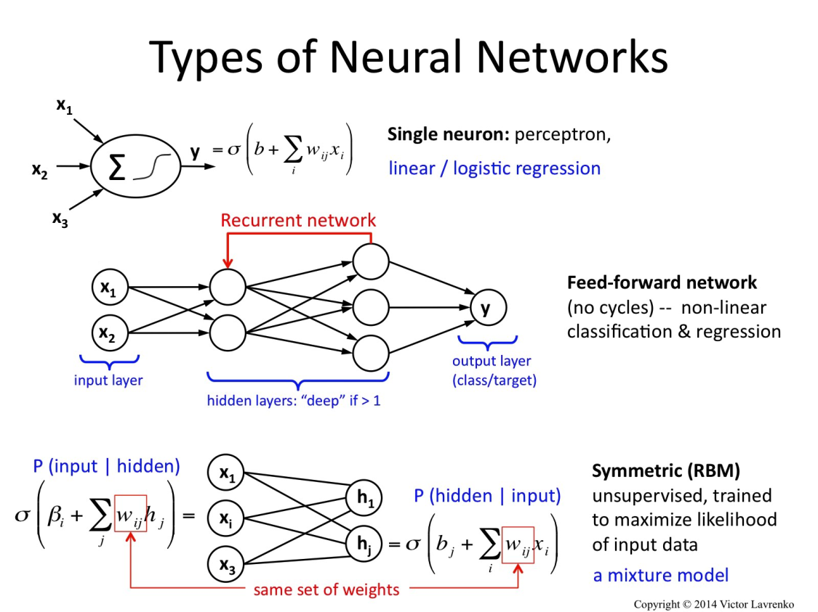
Types of ANN

Slide 17
Single
Feed Forward
Recurrent
Symmetric
Convolutional
Back propagation

Slide 18
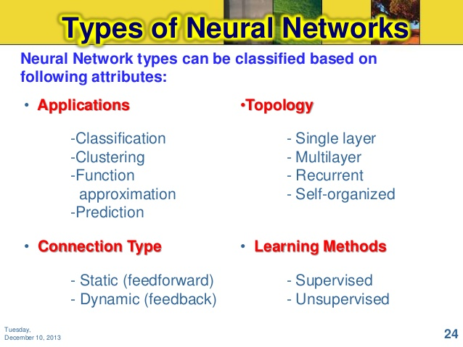

Slide 19
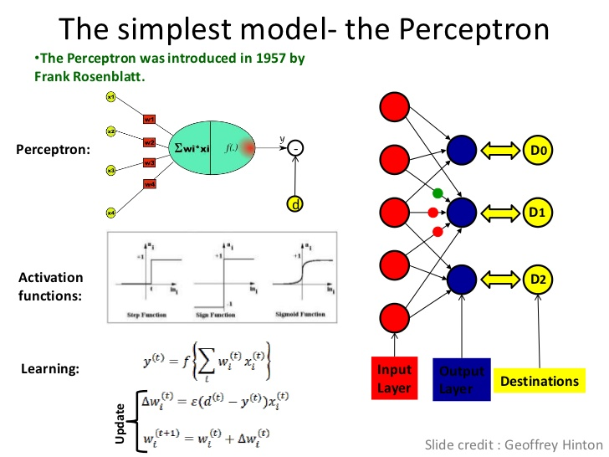

Slide 20
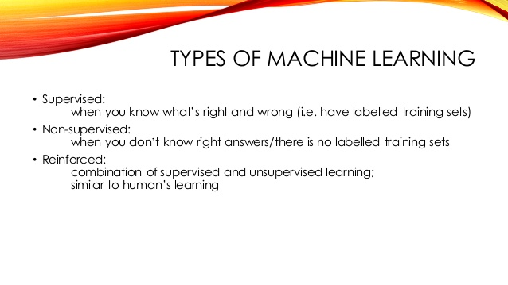
Reinforced ML

Slide 21
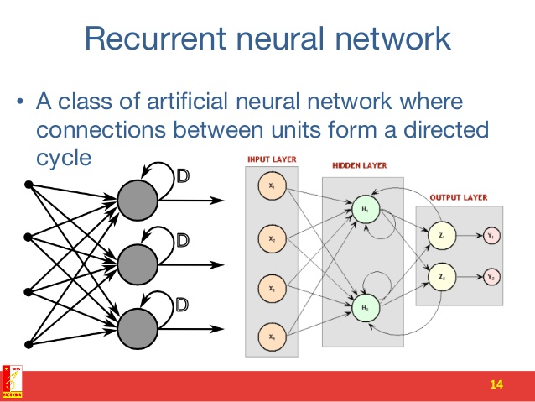
R NN

Slide 22
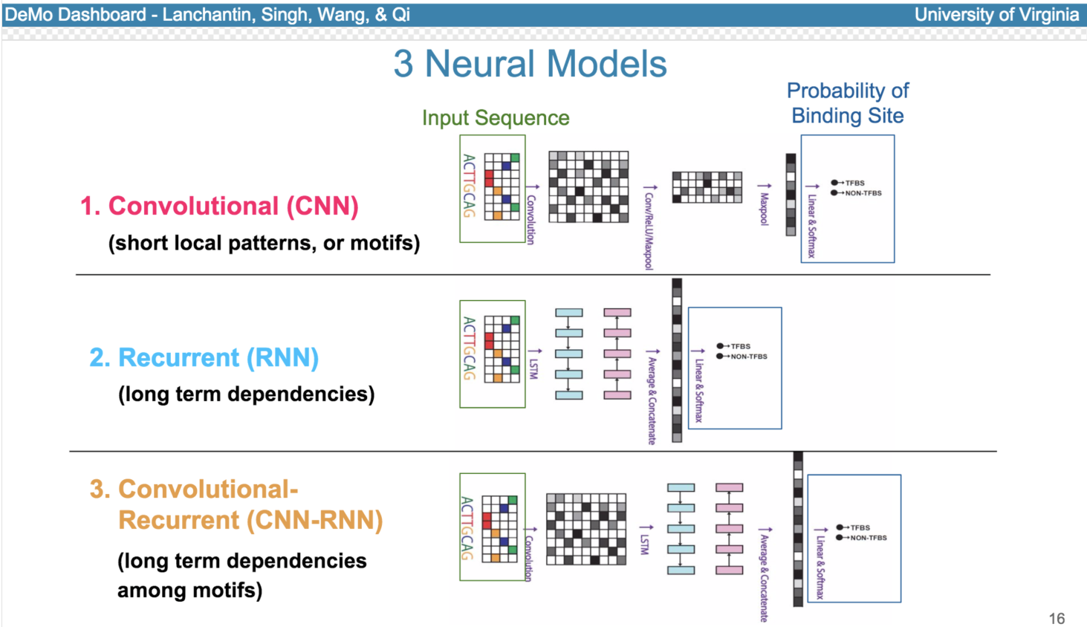

Slide 23
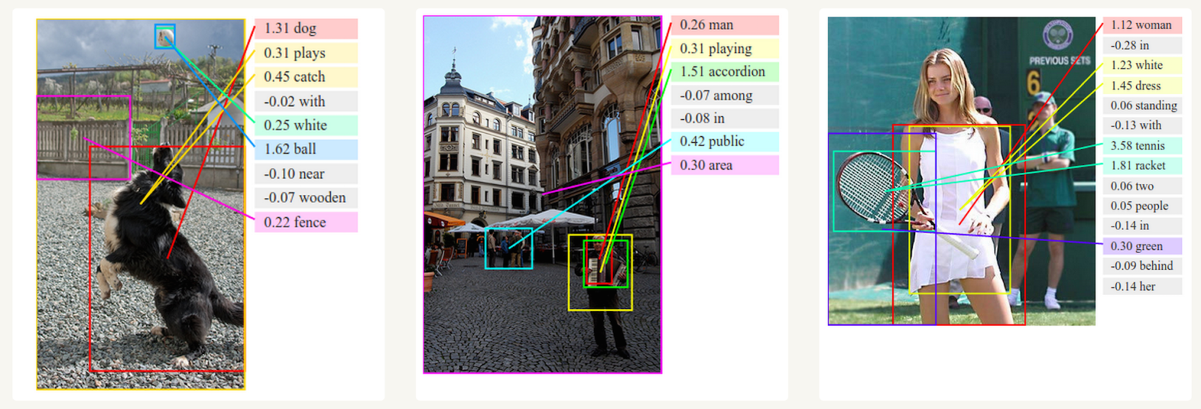

Slide 24
For example, in image recognition, they might learn to identify images that contain cats by analyzing example images that have been manually labeled as "cat" or "no cat" and using the results to identify cats in other images

Slide 25
An ANN is based on a collection of connected units or nodes called artificial neurons which loosely model the neurons in a biological brain

Slide 26
including
computer vision,
speech recognition,
machine translation,
social network filtering,
playing board and video games and medical diagnosis.

Slide 27
Hebb Learning
In the late 1940s, D.O. Hebb^{[4]} created a learning hypothesis based on the mechanism of neural plasticity that became known as Hebbian learning. Hebbian learning is unsupervised learning. This evolved into models for long term potentiation. Researchers started applying these ideas to computational models in 1948 with Turing's B-type machines.

Slide 28
Rosenblatt (1958) created the perceptron, an algorithm for pattern recognition
With mathematical notation,

Slide 29
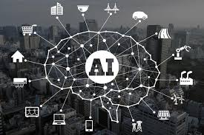
Artificial Intelligence

Slide 30
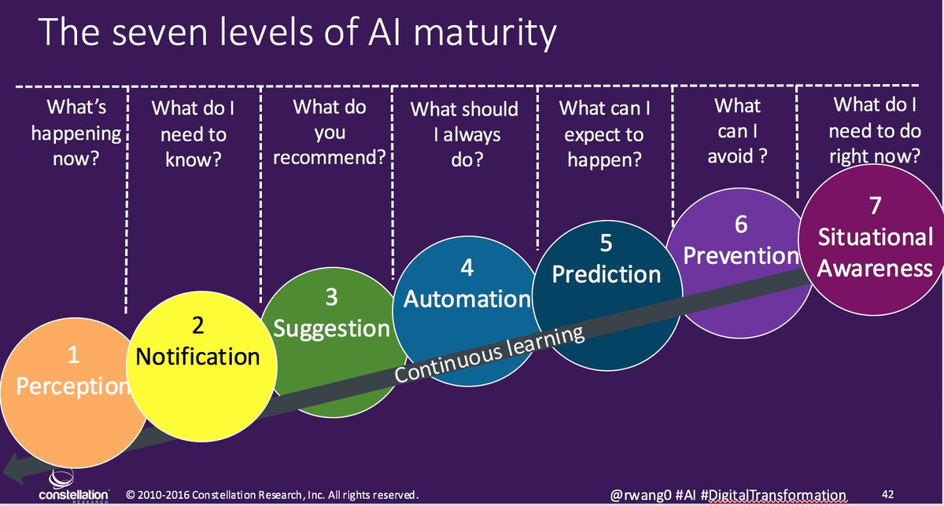

Slide 31
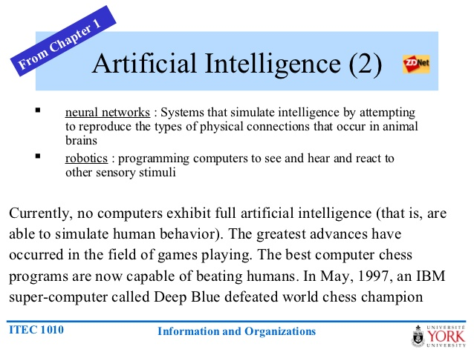

Slide 32
